Slide 1
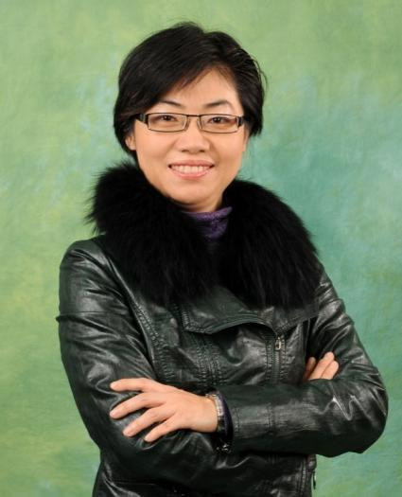
轉消費為收入
Convert Spending Into Earning
Nora Siu
總顧問經理級
National Supervising Coordinator
四個佣金週期共賺取HK$76,600
HK$76,600 in 4 Commission weeks
本簡報中提到的收入等級純屬舉例說明，無意代表美安香港超連鎖店主的一般收入，也無意表示任何超連鎖店主皆可賺取同等收入。美安香港超連鎖店主的成功與否，取決於其在發展事業時的努力、才能與投入程度。The income levels mentioned in the following presentation are for illustration purposes only. They are not intended to represent the income of a typical Market Hong Kong UnFranchise Owner, nor are they intended to represent that any given Independent UnFranchise Owner will earn income in that amount. The success of any Market Hong Kong Independent UnFranchise Owner will depend upon the amount of hard work, talent, and dedication which he or she devotes to building his or her Market Hong Kong Business.

Slide 2
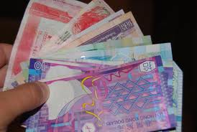
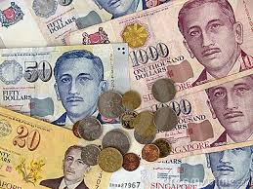
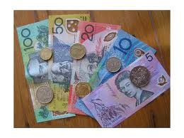
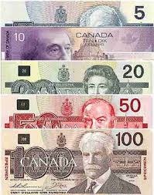
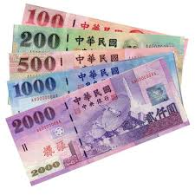


Slide 3


Slide 5



Slide 6

轉消費為收入

Slide 7


還有…
One more Thing ….

Slide 8
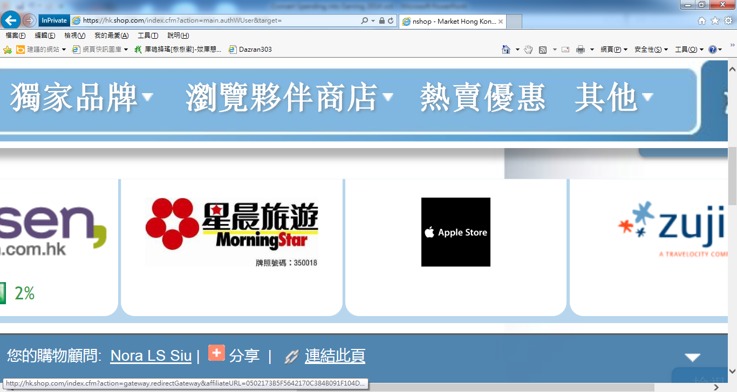

Slide 9


Slide 10


Slide 11
轉消費為收入
Convert Spending Into Earning
Nora Siu
總顧問經理級
National Supervising Coordinator
四個佣金週期共賺取HK$76,600
HK$76,600 in 4 Commission weeks
本簡報中提到的收入等級純屬舉例說明，無意代表美安香港超連鎖店主的一般收入，也無意表示任何超連鎖店主皆可賺取同等收入。美安香港超連鎖店主的成功與否，取決於其在發展事業時的努力、才能與投入程度。The income levels mentioned in the following presentation are for illustration purposes only. They are not intended to represent the income of a typical Market Hong Kong UnFranchise Owner, nor are they intended to represent that any given Independent UnFranchise Owner will earn income in that amount. The success of any Market Hong Kong Independent UnFranchise Owner will depend upon the amount of hard work, talent, and dedication which he or she devotes to building his or her Market Hong Kong Business.

Slide 12



